Slide 1
Natural Language Processing
Project Presentation

Slide 2
Our Team
Team Members:
Atharva Chundurwar
Sai Teja Bandaru
Bhaskar Bose
Dhruv Rakeshkumar Prajapati
Tejas Ajay Parse

Slide 3
Problem Statement
As large language models (LLMs) become increasingly integrated into complex problem-solving tasks, ensuring the quality of their reasoning chains is critical for reliable outputs. Existing evaluation methods often overlook the need for in-depth analysis of how reasoning steps are constructed. The proposed system aims to automatically evaluate reasoning chains generated by LLMs by categorizing them into broad and sub-level error types based on a custom error taxonomy. These errors may include wrong reasoning, wrong assumptions, contradiction, hallucination or more. The goal is to assess the overall structure and quality of the reasoning process. By classifying errors and providing actionable insights, the system will offer a robust framework for evaluating and improving the reasoning capabilities of LLMs, helping to identify and rectify flawed inference patterns in AI-generated responses.

Slide 4
Background Work
The background work involves thorough research of 3 main research papers which aid us with designing the error taxonomy and the auto-evaluator model. The research papers we went through were:
LogiQA: A Challenge Dataset for Machine Reading Comprehension with Logical Reasoning [1]
The Argument Reasoning Comprehension Task: Identification and Reconstruction of Implicit Warrants [2]
Step-by-Step Reasoning to Solve Grid Puzzles: Where do LLMs Falter? [3]

Slide 5
Datasets Analyzed
ARCT
LogiQA
The Argument Reasoning Comprehension Task (ARCT) dataset focuses on identifying and reconstructing implicit warrants that connect claims and premises in natural language arguments. It contains 1,200 examples to evaluate models' ability to comprehend and reason about underlying logical connections.
The LogiQA dataset is a machine reading comprehension benchmark designed to test logical reasoning abilities using 8,678 expert-crafted QA pairs. It evaluates deductive reasoning across various logical forms, highlighting a significant gap between human performance and state-of-the-art neural models.

Slide 6


Models Utilized
LLAMA
Gemini
LLaMA (Large Language Model Meta AI) is an open-source language model developed by Meta, designed for efficient performance in a wide range of NLP tasks with a focus on research and accessibility.
We have used “Llama 3-70B” for this project.
Gemini is a closed-source large language model developed by Google, known for its advanced capabilities in natural language understanding and generation.
We have used “gemini-1.5-pro 002” for this project.

Slide 7
Approach
First we used LLama 3-70B and Gemini-1.5 pro 002 to generate reasoning chains based on the ARCT and LogiQA datasets, then we proceeded with manually analysing the reasoning chains to see where the LLMs falter and what type of errors they make while analysing the chains. To our surprise many of the reasoning chains they analysed were incorrect which lead to an incorrect conclusion i.e. the model predicting a wrong output.
We aimed at finding the steps where the LLMs go wrong and classify the sentences into proper error taxonomies just like a human being would evaluate it.

Slide 8
Initial Accuracies
Dataset \ Models | Llama-3 | Gemini
Accuracy (LogiQA) | 31.34% | 61.14%
Accuracy (ARCT) | 54.28% | 85.14%

Slide 9
Initial Results Analysis
We see here that the closed source model (Gemini) is giving a better performance on both datasets. Following this model evaluation, we select correct and incorrect samples and develop a common error taxonomy by manually evaluating the reasoning chains.

Slide 10
Approach on Finding Taxonomies
We manually evaluated two datasets (LogiQA and ARCT), by considering 10 reasoning chain samples each(5 correct predictions and 5 incorrect predictions), and documented the common issues in the reasoning chains outputted by the LLMs. We then clustered these issues into five broad categories: Right Premise, Right Conclusion; Right Premise, Wrong Conclusion; Wrong Premise, Right Conclusion; Wrong Premise, Wrong Conclusion; and No Conclusion.
Following this, we defined multiple subcategories for both wrong premises and wrong conclusions, which will be presented in the following slides

Slide 11
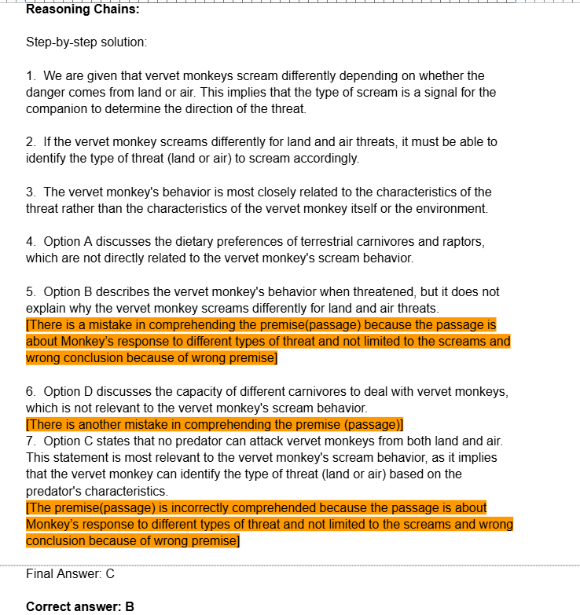
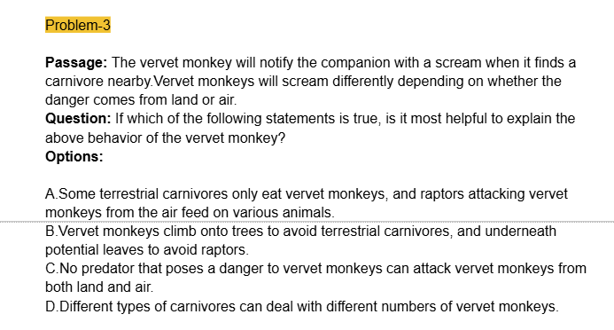
Screenshot of Manually Analyzed Chain
Text Here

Slide 12
Error Taxonomies
Following are the Categories:
RR: Right Premise, Right Conclusion
RW: Right Premise, Wrong Conclusion
WR: Wrong Premise, Right Conclusion
WW: Wrong Premise, Wrong Conclusion
NC: No Conclusion: Sentences containing only information from Problem, options or premises from previous steps fall under this category.

Slide 13
Error Taxonomies
Following are the Sub-Categories for Wrong Premise:
Error propagation: Premise taken from previous wrong conclusion.
Misinterpretation: Misinterpretation of passage, options or previously concluded steps in premise.

Slide 14
Error Taxonomies
Following are the Subcategories for Wrong Conclusion:
Insufficient information: Draws conclusions based on insufficient information.
Wrong assumption: Assumes conditions which leads to wrong conclusion.
Contradiction: Draws Conclusion that contradicts a previous premise
Misinterpretation: Misinterpretation of passage, options or previously concluded steps in premise[prominent for passage based problems].
Hallucination: Considers out of context information leading to wrong conclusion.
Wrong Reasoning: Gives wrong conclusion irrespective of premise[prominent for clue and arrangement based problems].
Error propagation: Conclusion drawn from wrong premise.

Slide 15
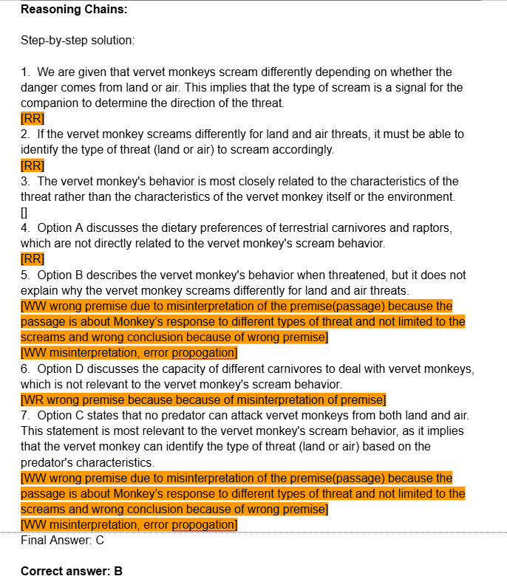
Chain Example with Error Taxonomies

Slide 16
Auto Evaluator
The Auto Evaluator is a LLM-based tool designed to assess and classify reasoning chains produced by other LLMs.
It leverages error taxonomies and few-shot prompting to identify and correct logical errors, enabling automated and consistent evaluation of reasoning quality.

Slide 17
Approach to Auto-Evaluator
Zero-shot and one-shot prompting struggled due to excessively long prompts that included all error taxonomies, examples, questions, and options. These prompts often exceeded processing limits, preventing the model from breaking reasoning chains into manageable lines. As a result, the model frequently generated incorrect or incomplete answers, undermining its effectiveness.
Custom GPTs addressed these limitations by structuring error analysis more effectively within processing constraints. By segmenting and organizing the information, they enabled precise reasoning without overloading the prompt. This approach ensured accurate and coherent responses, improving overall analysis and usability.

Slide 18
Approach to Auto-Evaluator
We broke the approach into two steps:
Developed Custom GPT by fine-tuning an LLM to accurately split reasoning chains step-by-step without hallucinating or misinterpreting commands. This ensures it only processes and analyzes text explicitly present in the input reasoning chains. The refined instruction set is saved for consistent use. Main aim of this step was to create a Instruction Set where model splits the reasoning chains line by line without hallucinating.
Integrated the error taxonomy into existing CustomGPT by instructing it to assign one label (e.g., NC, RR, RW, WR, WW) to each reasoning chain. To guide the process, we provide an example of a manually evaluated and labeled reasoning chain, demonstrating the expected output format. This ensures the model understands the classification criteria and applies the taxonomy consistently. Custom GPT can then analyze and label reasoning chains efficiently using the provided structure.

Slide 19
Auto-Evaluator Results
 | Accuracy (in %)
Broad Category | 81.98
Sub Category | 56.79

Slide 20
Future Work
Tune the error taxonomies on similar reasoning datasets to develop a global and more universally applicable taxonomy.
Evaluate the performance of the auto evaluator across diverse datasets and refine its instructions for better generalization.
Explore the use of human-in-the-loop approaches to enhance error labeling accuracy in complex cases.

Slide 21
References
Liu, Jian, et al. "Logiqa: A challenge dataset for machine reading comprehension with logical reasoning." arXiv preprint arXiv:2007.08124 (2020).
Habernal, Ivan, et al. "The argument reasoning comprehension task: Identification and reconstruction of implicit warrants." arXiv preprint arXiv:1708.01425 (2017).
Tyagi, Nemika, et al. "Step-by-Step Reasoning to Solve Grid Puzzles: Where do LLMs Falter?." arXiv preprint arXiv:2407.14790 (2024).

Slide 22
Any Questions?

Slide 23
Thank You

